Slide 1
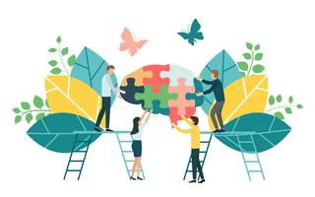
My Ideal Vision for a Rural Elementary School
https://www.vecteezy.com/free-vector/team-collaboration
https://www.vecteezy.com/free-vector/collaboration
Madison Webb
EDUC 393: Foundations of Education
University of Northern British Columbia
November 27, 2023
Notes:
Hello everyone! I’d like to share my ideal vision for a rural elementary school.

Slide 2
Guiding Principles & Values
Nurture a strong sense of community built upon mutual respect
Cultivate a calm environment with effective structure
Strong focus on foundational literacy skills
Consider context and care for the whole learner
https://www.istockphoto.com/vector/compass-gm503891738-82838967
Notes:
My ideal school would have a strong sense of community and shared values. It would be the kind of school you walk into and immediately sense that the school culture is warm, healthy, and focused on student success.
Mutual respect between students, staff, and teachers, a genuine belief in student capability, teamwork, and recognizing hard work would be the foundational values of my ideal school environment.
To support the development of these values, there would be a strong focus on foundational skills coupled with the cultivation of a calm classroom environment with effective structure.
Lastly, because we know that students do not leave their struggles outside of school at the door, my ideal school would consider context and honour the whole learner.
Throughout my presentation, you will see how these guiding principles come into play.

Slide 3
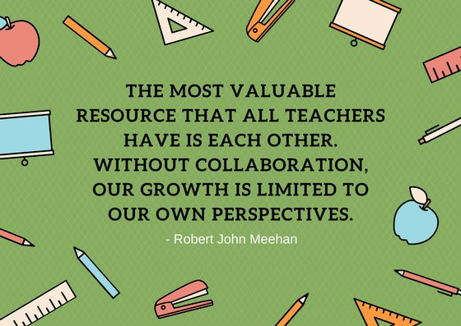
Building a Cohesive School Culture Begins with the Staff
A daily 10 minute morning staff meeting would be implemented before the morning bell rings to support staff relationships and stay up to date on any housekeeping.
Teachers would be encouraged to collaborate with one another and bring their classes together so students from different grades have the chance to learn from and alongside one another.
This would help both students and staff view themselves as a school-wide team and community.
https://twitter.com/theCEI/status/1009816026610102272
Notes:
To support the development of staff relationships, my ideal school would implement brief, daily morning staff meetings before the morning bell. This would allow staff to see and greet one another before the day began, receive housekeeping updates, and begin the day on the same page.
Research tells us that strong, positive school cultures are built in part by collaborative collegial relationships (Jerald, 2006). So, teachers would also be encouraged to plan collaborative activities with one another and bring their classes together so that students from different grade levels or classrooms have the chance to learn from and alongside one another.
My elementary school used a buddy-class system where students from older grades were paired with students from younger grades and you would get together and do things like practice reading aloud to one another, art projects, or help the younger group prepare for their parent-teacher conferences. That system worked well from a student perspective.
I think this type of collaboration helps both students and staff to view themselves as a school-wide team and community.

Slide 4
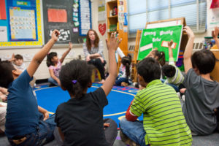
Morning Meeting
The 4 basic parts of the Morning Meeting Model developed by Kriete and Davis (2014) are:
Greeting
Sharing
Group Activity
Morning Message/Announcements
Morning Meetings can be an effective way to build structured routines, foster a sense of trust and mutual respect, and develop a sense of community in the classroom (Kriete & Davis, 2014).
https://www.flaticon.com/premium-sticker/good-morning_6106779
https://www.responsiveclassroom.org/what-is-morning-meeting/
Notes:
Along a similar vein, to facilitate the development of positive classroom cultures and communities, I would encourage classroom teachers to adopt a routine that includes daily morning meetings with their students.
The “Morning Meeting” model was developed by Roxann Kriete and Carol Davis (2014) and it involves 4 basic stages.
Step 1 of the Morning Meeting is to greet one another by name (Kriete & Davis, 2014). This is part of intentionally building community by explicitly noticing one another. You want your students to know that it matters that they are in your classroom community.
Step 2 is about sharing (Kriete & Davis, 2014). Each student is allowed to share something from their life that is important to them (if they wish to) while the other students have the opportunity to listen and respond respectfully.
Step 3 is participating in a short group activity (Kriete & Davis, 2014). This is where you can incorporate cross-curricular components relevant to what your class is working on that day. This could involve playing a game, reading a story, practicing a math skill in small groups, singing a song, etc. The idea is that this activity is engaging and allows students to exercise and/or develop their social and academic skills (Kriete & Davis, 2014).
Step 4 is delivering the morning message or announcements for the day to your students (Kriete & Davis, 2014). This could be done by simply reviewing the day’s schedule.
These short, 15 to 30-minute meetings are intended to set a positive, respectful tone in the classroom for both students and teachers (Responsive Classroom, 2023).
Morning Meetings can be an effective way to build structured routines, foster a sense of trust and mutual respect, and develop a sense of community in the classroom (Kriete & Davis, 2014).

Slide 5
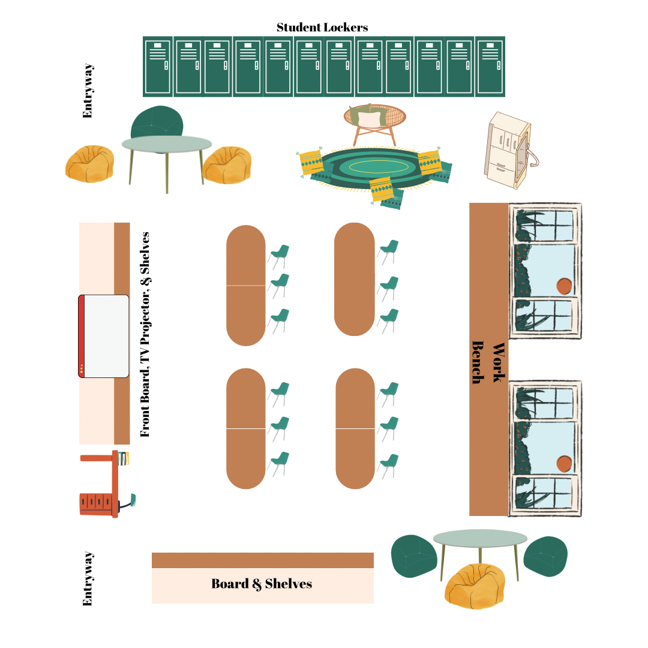
Classroom Layout
Lots of natural light
Students seated in small groups at tables
Some options for seating
Lots of space to work
Notes:
My ideal classroom layout also reflects my desire to build a sense of calm, structure, and choice into the learning environment.
I made this picture of my ideal classroom layout on Canva.
You can see that there is a good deal of natural light coming into the classroom with the large windows at the back of the room. I wanted to create a calm, orderly, and somewhat organic feel in the room so I prioritized natural light, lots of earth tones in the colour scheme, and some options for seating and workspaces.
Ideally, students would be seated at tables – about three to a table so that they can collaborate but also have enough space to work independently when needed.
I also have all my seats facing the front of the room so that each student has a good chance of being able to see the board and the teacher.
Building in choice by providing some different areas that students could choose to move to to do their work was also a priority as I set up the room. That is why I have two round tables set up with bean bag seats and a long workbench at the back of the room.
Having some flexibility and allowing for structured student choice will help students feel comfortable and ready to learn (M. Baerg, personal communication, Nov. 13, 2023).
I also thought the workbench and the round tables would be helpful when setting up stations or differentiated activities.
I also have some cushions at the carpet area so students can choose if they are more comfortable with or without a cushion.
To include technology in the classroom, there is a smart TV. There would also be a class set of iPads within the room because tablets have been shown to have a positive impact on learning and the potential to accelerate learning when used appropriately (Hamilton & Hattie, 2021). There would also be a class set of laptops within the school as well as a computer lab.
I have also put a bank of student lockers in the room so that each student has their own area to store their belongings. This could help to create a sense of security and agency for some students. The lockers would not necessarily have locks on them but the lockers themselves would still provide separate areas for each student.

Slide 6
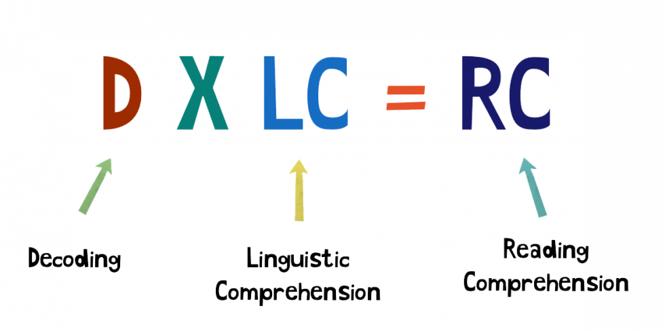
Effective Focus on Foundational Literacy Skills
An effective, science-backed focus on foundational literacy skills would be central to my ideal school’s approach.
The pillars of reading instruction are phonemic awareness, phonics, fluency, vocabulary and comprehension (M. Baerg, personal communication, November 13, 2023).
All of these aspects would be attended to in my ideal school by UFLI and differentiated primary reading groups.
Schools using UFLI Foundations have seen significant student progress in oral reading fluency, phonemic awareness, and decoding (UFLI, n.d.).
The idea behind pairing UFLI with primary reading groups is that UFLI addresses decoding while the primary reading groups address linguistic and reading comprehension. Together, they address all aspects of the “Simple View of Reading” formula (M. Baerg, personal communication, November 13, 2023).
https://ufli.education.ufl.edu/foundations/
Notes:
An effective, science-backed focus on foundational literacy skills would be central to my ideal school’s approach.
All of my relationship-building, and calm, structured classroom environment pieces build into and support my vision for an effective focus on foundational literacy skills. Hopefully, these aspects of my ideal school environment will help students to self-regulate and soothe dysregulation, therefore helping students maintain a manageable cognitive load.
So much of the world opens up when you are a proficient reader and the foundational skills are vitally important for continued student success.
The pillars of reading instruction are phonemic awareness, phonics, fluency, vocabulary and comprehension (M. Baerg, personal communication, November 13, 2023). All of these aspects would be attended to in my ideal school by UFLI and targeted primary reading groups.
The University of Florida Literacy Institute Foundations (UFLI) program is research and evidence-based. Schools using UFLI Foundations have seen significant student progress in oral reading fluency, phonemic awareness, and decoding (UFLI, n.d.).
UFLI targets a range of foundational reading skills including decoding and encoding, reading and spelling irregular words, phoneme blending and segmentation, and accuracy and automaticity of grapheme-phoneme correspondences all supported by explicit introductions to new concepts (UFLI, n.d.).
The program provides step-by-step lesson plans that follow a set 8-step routine so it is very structured (UFLI, n.d.). According to their website, UFLI is most focused on decoding. As we know, being able to decode words gives students the tools to read any word.
The idea behind pairing UFLI with primary reading groups is that UFLI addresses decoding while the primary reading groups address linguistic and reading comprehension. Together, they address all aspects of the “Simple View of Reading” formula (M. Baerg, personal communication, November 13, 2023).

Slide 7
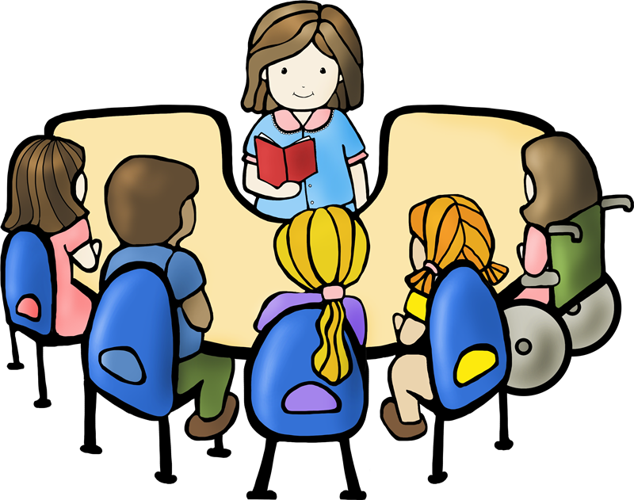
Primary Reading Groups
Primary reading groups would be created where students from Grades 1 through 3 were mixed and matched to reading groups according to their current reading level. By differentiating instruction in this way, you recognize the diversity in your classroom and attend to different readiness levels (Avella, 2017).
This approach would require significant teacher collaboration and educational assistant (EA) support to ensure that each reading group was led by an adult each day.
Ideally, the classroom teachers and EAs would rotate leading different reading groups so the groups and students could be viewed from different perspectives and expertise.
https://flyclipart.com/clipart-reading-groups-clip-art-images-person-reading-clipart-137932
Notes:
My ideal school would create primary reading groups where students from Grades 1 through 3 were mixed and matched to reading groups according to their current reading level. By differentiating instruction in this way, you recognize the diversity in your classroom and attend to different readiness levels (Avella, 2017). Primary reading groups allow each student to get the support they need and be challenged appropriately. These groups would meet daily. I have seen and supported this style of multi-grade primary reading groups as an EA and the results so far are very encouraging.
This approach would require significant teacher collaboration and educational assistant support to ensure that each reading group was led by an adult each day. Ideally, the classroom teachers and EAs would rotate leading different reading groups so the groups and students could be viewed from different perspectives and expertise.
The reading groups would be somewhat fluid throughout the year to allow students to be moved to different levels when necessary.

Slide 8
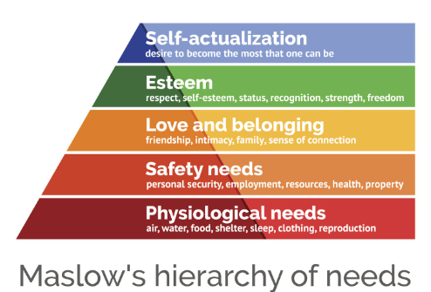
Considering the Whole Learner
Considering the whole learner and context is a thread I am trying to pull throughout my entire vision (eg. food programs, nurturing relationships, authentic Indigenous education, etc.) because learning does not happen in isolation!
Maslow’s (1954) Hierarchy of Needs puts forward the idea that when our physiological needs are not being met, it is extremely difficult to progress up the hierarchy (M. Baerg, personal communication, Oct. 16, 2023).
https://www.thoughtco.com/maslows-hierarchy-of-needs-4582571
Notes:
Up next, we have considering the whole learner. One of the most important lessons I have taken out of this block of the program is that learning does not happen in isolation!
In that spirit, considering the whole learner is a thread I have tried to pull throughout my vision and hopefully, you can see that in my commitment to nurturing staff and student relationships and the food programs and cultural representation efforts I will be introducing in a moment.
As we have reviewed in this course, Maslow’s Hierarchy of Needs puts forward the idea that when our physiological needs are not being met, it is extremely difficult to progress up the hierarchy (M. Baerg, personal communication, Oct. 16, 2023).
I also suspect that regardless of our best efforts, it would be extremely difficult to reach a level of “relaxed alertness” when your basic needs are not being met (Hammond, 2017).

Slide 9
Food Programs
Breakfast Clubs of Canada (2020).
Non-profit organization that works to fund school programs to provide nutritious breakfasts to all students.
BC Agriculture in the Classroom Foundation (2023).
Non-profit organization that works to bring BC’s agriculture into schools because they believe students deserve to eat the best fruits and veggies.
Backpack Buddies (2023).
Charity that works to address the weekend hunger gap.
Students cannot do their best learning when they are hungry.
To help honour students as whole learners, my ideal school would have a series of programs in place to help ensure students had access to the nourishment they need.
https://www.breakfastclubcanada.org /
https://bcaitc.ca/
https://www.backpackbuddies.ca/
Notes:
We know that students cannot do their best learning when they are hungry so to help honour students as whole learners, my ideal school would have a series of programs in place to help ensure students have access to the nourishment they need to succeed.
I have identified three programs that I feel would work well together.
Firstly, my ideal school would work with Breakfast Clubs of Canada (2020) which is a non-profit organization that works to establish and fund tailored in-school programs to provide nutritious breakfasts to all students at no cost to the students.
I would also work with the BC Agriculture in the Classroom Foundation. This organization has a program called the BC School Fruit and Vegetable Nutritional Program driven by the belief that all BC students deserve to eat the best fruits and veggies this province has to offer (BC Agriculture in the Classroom, 2023). They are a non-profit organization committed to bringing the story of where food comes from, healthy eating and the knowledge that eating BC produce supports local farmers and economies together in the classroom. The program brings fresh produce into schools 12x a year. This not only helps to nourish students physically, but it also allows students to try different types of produce they may not otherwise try.
Lastly, my ideal school would also work with a charity known as Backpack Buddies to try to bridge the weekend hunger gap.
For families that are experiencing food insecurity and depend on school food programs, the weekend can be a particularly stressful time (Backpack Buddies, 2023). Backpack Buddies works with teachers and school administrators to identify students who would benefit from receiving a bag of ready-to-eat food to take with them over the weekend. Each bag is delivered discreetly to preserve the students’ dignity.

Slide 10
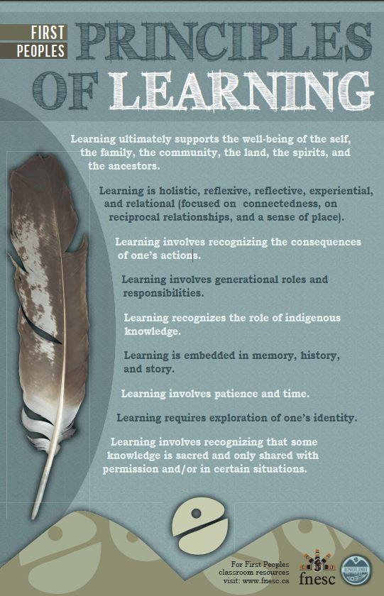
Elder-in-Residence & Authentic Indigenous Representation
My ideal school would work diligently to address the Truth and Reconciliation Commission Calls to Action & Standard 9 (Truth and Reconciliation Commission of Canada, 2015b; BC Teachers’ Council, 2019).
An Elder-in-Residence program would provide all students with the opportunity to learn about local Indigenous cultures directly from Indigenous individuals through their own voices, stories, and experiences.
An Elder-in-Residence program would also encourage relationship-building and collaboration between teachers and Indigenous knowledge-holders as they work to infuse the public education system with more Indigenous perspectives.
Non-Indigenous teachers would be strongly encouraged to critically assess the resources they use in their classrooms using the authentic resource evaluation criteria developed by the First Nations Education Steering Committee (2021).
https://www.fnesc.ca/first-peoples-principles-of-learning/
https://www.portageandmainpress.com/Books/W/Wayi-Wah!-Indigenous-Pedagogies
Notes:
My ideal school would also prioritize authentic Indigenous education. Canada’s Indian Residential School system and its legacies demonstrate that Indigenous peoples, cultures, and knowledge systems have not historically been valued by the nation’s education systems (Truth and Reconciliation Commission of Canada, 2015a). The Truth and Reconciliation Commission’s Calls to Action (2015b) include calls for the creation and implementation of age-appropriate, mandatory Indigenous education curriculum throughout the K to 12 system as well as a commitment to building student capacity for intercultural understanding, empathy, and mutual respect.
Additionally, Professional Standard 9 requires educators to help themselves and their students develop a deeper understanding of Indigenous histories, cultures, and ways of knowing and being by integrating First Nations, Inuit, and Metis perspectives into the learning environment (BC Teachers’ Council, 2019).
To help address the need for reconciliation efforts and the incorporation of Indigenous perspectives in the school environment, my ideal school would have an Elder-in-Residence program so that all students have the opportunity to learn about local Indigenous cultures directly from Indigenous individuals through their own voices, stories, and experiences.
Depending on the vision and strengths of the Elders hired to work in this role, the program would look different because I envision them having creative control over what they choose to implement.
A program of this nature would honour the First Peoples Principles of Learning (First Nations Education Steering Committee, 2006/2007). I think it would target the following principles especially:
“Learning ultimately supports the well-being of the self, the family, the community, the land, the spirits, and the ancestors.”
“Learning involves generational roles and responsibilities.”
“Learning recognizes the role of indigenous knowledge.”
“Learning involves recognizing that some knowledge is sacred and only shared with permission and/or in certain situations.”
As Jo Chrona (2022) has repeatedly stressed, it is not appropriate for non-Indigenous educators to directly teach any cultural knowledge. Having Elders employed within the school to share appropriate knowledge would enrich the school environment with authentic Indigenous representation which benefits all students.
Having an Elder-in-Residence program would also allow for relationship-building and collaboration between teachers and Indigenous knowledge-holders as they work to infuse the public education system with more Indigenous perspectives.
Non-Indigenous teachers would infuse Indigenous perspectives and voices into their classrooms by using authentic resources developed by or in significant collaboration with Indigenous knowledge holders. Non-Indigenous teachers would be strongly encouraged to critically assess the resources they use in their classrooms using the authentic resource evaluation criteria developed by the First Nations Education Steering Committee (2021).

Slide 11
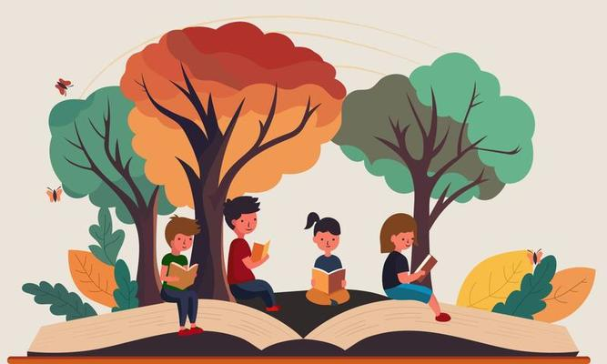
Structured Outdoor Walks
Research shows that outdoor learning can have positive psychological impacts (Harvey et al., 2020).
Spending even 1 hour per week learning outdoors can improve students’ well-being, mood, and connection to nature (Harvey et al., 2020).
Incorporating outdoor learning into the school day also helps to create opportunities for physical activity. Additionally, it allows students to gain a deeper understanding of the world around them and it brings learning alive in new ways (Beames et al., 2012).
https://www.vecteezy.com/free-vector/outdoor-learning
Notes:
Research shows that outdoor learning can have positive psychological impacts (Harvey et al., 2020). Spending even 1 hour per week learning outdoors can improve students’ well-being, mood, and connection to nature (Harvey et al., 2020). Incorporating outdoor learning into the school day also helps to create opportunities for physical activity, it allows students to gain a deeper understanding of the world around them and it brings learning alive in new ways (Beames et al., 2012).

Slide 12
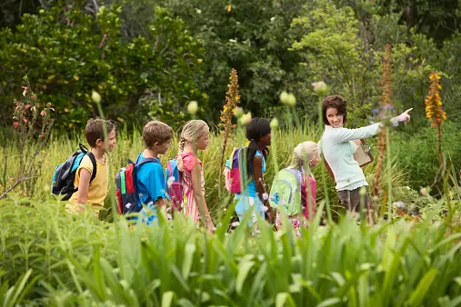
Structured Outdoor Walks
My ideal school would take students on structured, seasonal walks. This would be done at least 4 times per year so that students could take note of the seasonal shifts and develop their connection to the land.
Front-loaded science and social studies lessons would be given prior to the walk.
To build on this, local Indigenous language learning would be incorporated to create stronger connections with the land.
This model also provides an opportunity to develop Two-Eyed Seeing (Thomas, 2016). Both Western and Indigenous science and perspectives would be incorporated into the frontloaded lessons.
Dwayne Donald (2021), inspired by the Cree concept, wâhkôhtowin, argues that walking with intention on the land can help to teach and support the development of kinship relationality and a renewed understanding of the natural world.
These walks would also be a great opportunity for teacher collaboration.
https://unsplash.com/s/photos/outdoor-learning
Notes:
My ideal school would take students on structured, seasonal walks – this would be done at least four (4) times per year so that students could take note of the seasonal shifts and develop their connection to the land. I think it is important to take students outside to notice nature and spend time embracing the outside world intentionally.
I would give a lesson about the changing seasons or how the parts of an ecosystem work together in science, paired with a social studies lesson on the importance of caring for the environment before taking my students outside for a structured walk.
To build on this, it would be possible to incorporate local Indigenous language learning to create stronger connections with the land. We would practice using key terms related to the land, plants, and animals during our walk.
I think that this model also provides an opportunity to develop Two-Eyed Seeing (Thomas, 2016). Both Western and Indigenous science and perspectives would be incorporated into the frontloaded lessons.
Dwayne Donald (2021), inspired by the Cree concept, wâhkôhtowin, argues that walking with intention on the land can help to teach and support the development of kinship relationality and a renewed understanding of the natural world.
Furthermore, this approach allows for a great deal of cross-curricular connections to form.
These walks would be a wonderful opportunity for teachers to collaborate as well. As an EA I got to go on a structured walk which was geared toward noticing the transition between summer and fall – there was no explicit incorporation of Indigenous education, but the science and social studies elements were there.
Anyway, Kindergarten, Grade 1 and Grade 5 went on this particular walk. The students were buddied up so that each Grade 5 student was with a younger student and they got to practice being a leader and a role model to their younger buddy. Most of them seemed to really enjoy it. Since that activity, I have noticed a lot of the Grade 5 girls will come and play with the Kindergarteners in their playground at lunch time.

Slide 13
Any Questions?
Notes:
And that sums up my ideal vision. I hope you’ve been able to sense the goals and values that drove my ideas – thank you for listening!

Slide 14
References
Avella, F. [Teachings in Education]. (2017, July 30). Differentiated instruction: Why, how, and examples [Video]. YouTube. https://www.youtube.com/watch?v=8BVvImZcnkw
Backpack Buddies. (2023). How we help. https://www.backpackbuddies.ca/how-we-help/
BC Agriculture in the Classroom. (2023). BC school fruit and vegetable nutritional program. https://www.bcaitc.ca/bc-school-fruit-vegetable-nutritional-program
BC Teachers’ Council. (2019). Professional standards for BC educators. BC Teachers’ Council. https://www2.gov.bc.ca/assets/gov/education/kindergarten-to-grade-12/teach/teacher-regulation/standards-for-educators/edu_standards.pdf
Beames, S., Higgins, P., & Nicol, R. (2012). Learning outside the classroom: Theory and guidelines for practice. Routledge. https://doi-org.prxy.lib.unbc.ca/10.4324/9780203816011
Breakfast Club of Canada. (2020). School breakfast. https://www.breakfastclubcanada.org/school-breakfast/

Slide 15
References
Chrona, J. (2022). Wayi wah!: Indigenous pedagogies: An act for reconciliation and
anti-racist education. Portage & Main Press.
Donald, D. (2021). We need a new story: Walking and the wâhkôhtowin imagination. Journal of the Canadian Association of Curriculum Studies, 18(2), 53-63. https://doi.org/10.25071/1916-4467.40492
First Nations Education Steering Committee. (2006/2007). First Peoples principles of learning. https://www.fnesc.ca/first-peoples-principles-of-learning/
First Nations Steering Committee & First Nations Schools Association. (2021). Authentic First Peoples resources for grades 10-12 and adult learning. https://www.fnesc.ca/wp/wp-content/uploads/2021/03/PUBLICATION-Authentic-Resources-10-12-supplement-2021-03-29.pdf

Slide 16
References
Hamilton, A., & Hattie, J. (2021). Not all that glitters is gold: Can education technology finally deliver? Corwin & Cognition Education Group. https://www.cognitionlearninggroup.com/wp-content/uploads/2022/04/Not-All-That-Glitters-is-Gold-2.pdf
Hammond, Z. [Corwin]. (2017, May 4). Zaretta Hammond: Culturally responsive teaching and the brain webinar [Video]. YouTube. https://www.youtube.com/watch?v=O2kzbH7ZWGg
Harvey, D. J., Montgomery, L. N., Harvey, H., Hall, F., Gange, A. C., & Watling, D. (2020). Psychological benefits of a biodiversity-focused outdoor learning program for primary school children. Journal of Environmental Psychology, 67. https://doi.org/10.1016/j.jenvp.2019.101381
Jerald, C. D. (2006). School culture: The hidden curriculum. https://www.readingrockets.org/topics/school-wide-efforts/articles/school-culture-hidden-curriculum

Slide 17
References
Kriete R. & Davis C. (2014). The morning meeting book: K-8 (3rd ed.). Northeast Foundation for Children.
Responsive Classroom. (2023). What is morning meeting? https://www.responsiveclassroom.org/what-is-morning-meeting/
Thomas, R. [TEDx Talks]. (2016, June 13). Etuaptmumk: Two-eyed seeing [Video]. YouTube. https://www.youtube.com/watch?v=bA9EwcFbVfg
Truth and Reconciliation Commission of Canada. (2015a). Honouring the truth, reconciling for the future: Summary of the final report of the Truth and Reconciliation Commission of Canada (Catalogue No. IR4-7/2015E-PDF). https://publications.gc.ca/collections/collection_2015/trc/IR4-7-2015-eng.pdf
Truth and Reconciliation Commission of Canada. (2015b). Truth and Reconciliation Commission of Canada: Calls to action (Catalogue No. IR4-8/2015E-PDF). https://publications.gc.ca/site/eng/9.801236/publication.html
University of Florida Literacy Institute. (n.d.). UFLI foundations. https://ufli.education.ufl.edu/foundations/

